Slide 1
LUM-1N
An extra –terrestrial contact

Slide 2

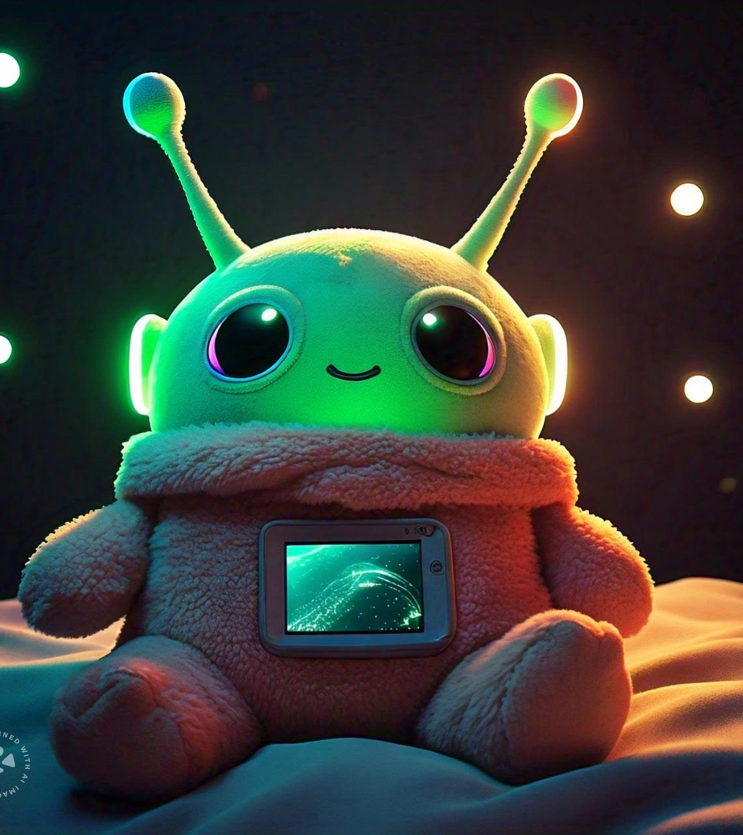
Outer space might look far away for most of us: unreachable lands and mystical bright starts that hide misterious and ancient secrets, only witnessed for super heroes who have adapted to the hostile environments.
But… what if I told you that there’s a portal that can connect us to this super humans in the middle of never ending galactic quests?
After years of supernovas sighting and black holes heroic scapes, our heroes found themselves in the newly discovered LUV-17, a cold pale exoplanet filled with an unpredicatable result: life!

Slide 3
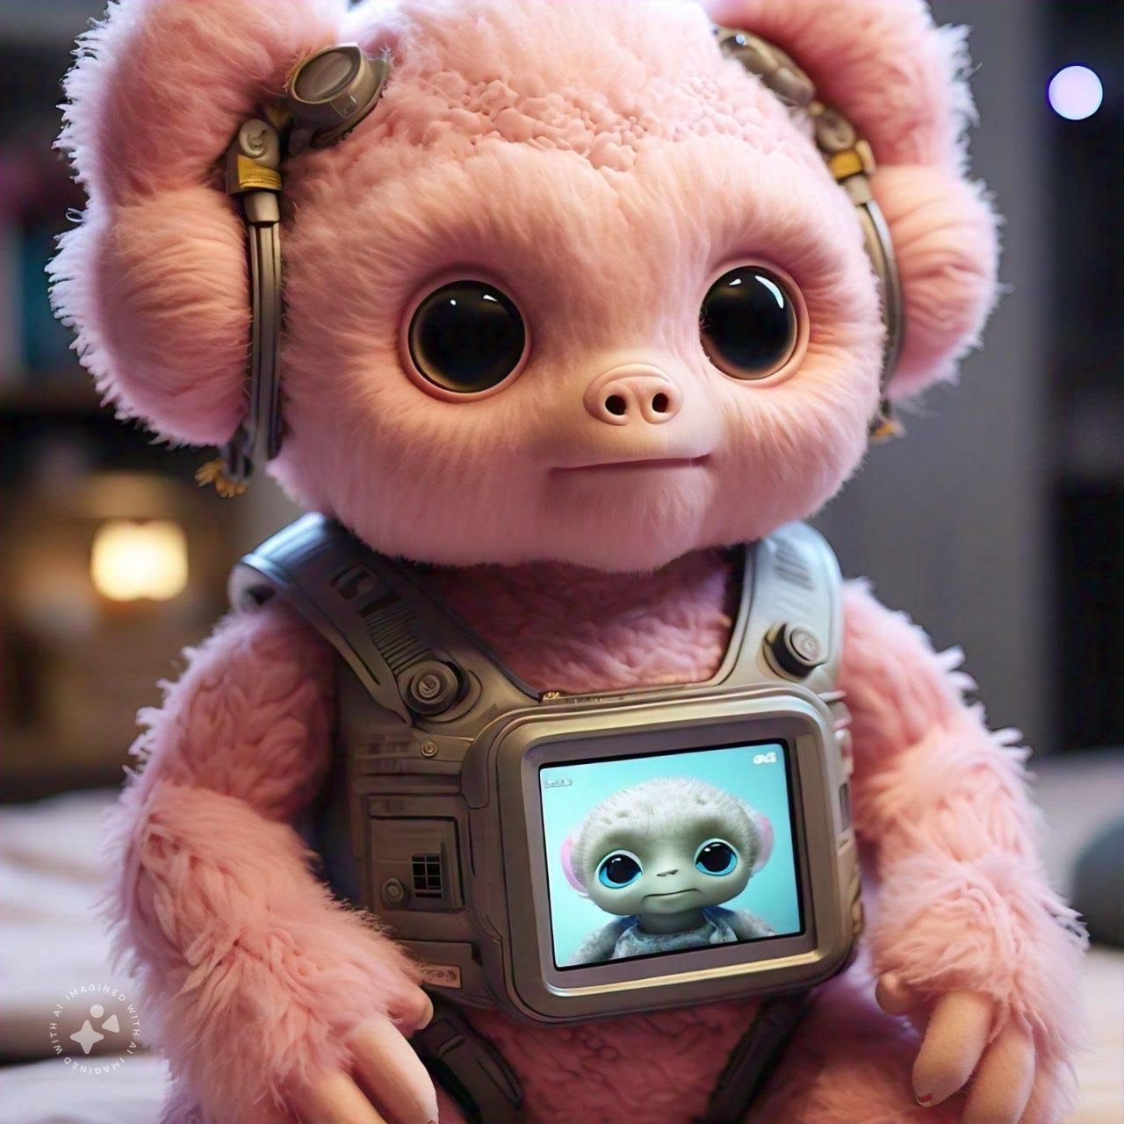
What or who are the lum-1n?
The long distance gap between astronauts and their communities might be a delicate topic for some to deal with. Days, months, and even years far from them can make the outer space life feel cold and rutinary.
LUM-1N is a soft little buddy whose life mission is to share galactic messages to earthlings. Picture a kid friendly creature whose physical contact can put you in real time contact with our space heroes. There’s no better way to feed curiosity and build interest in the vast outer space than giving kids a little glimpse of heroic attention, a first tact with astronomic knowledge.

Slide 4
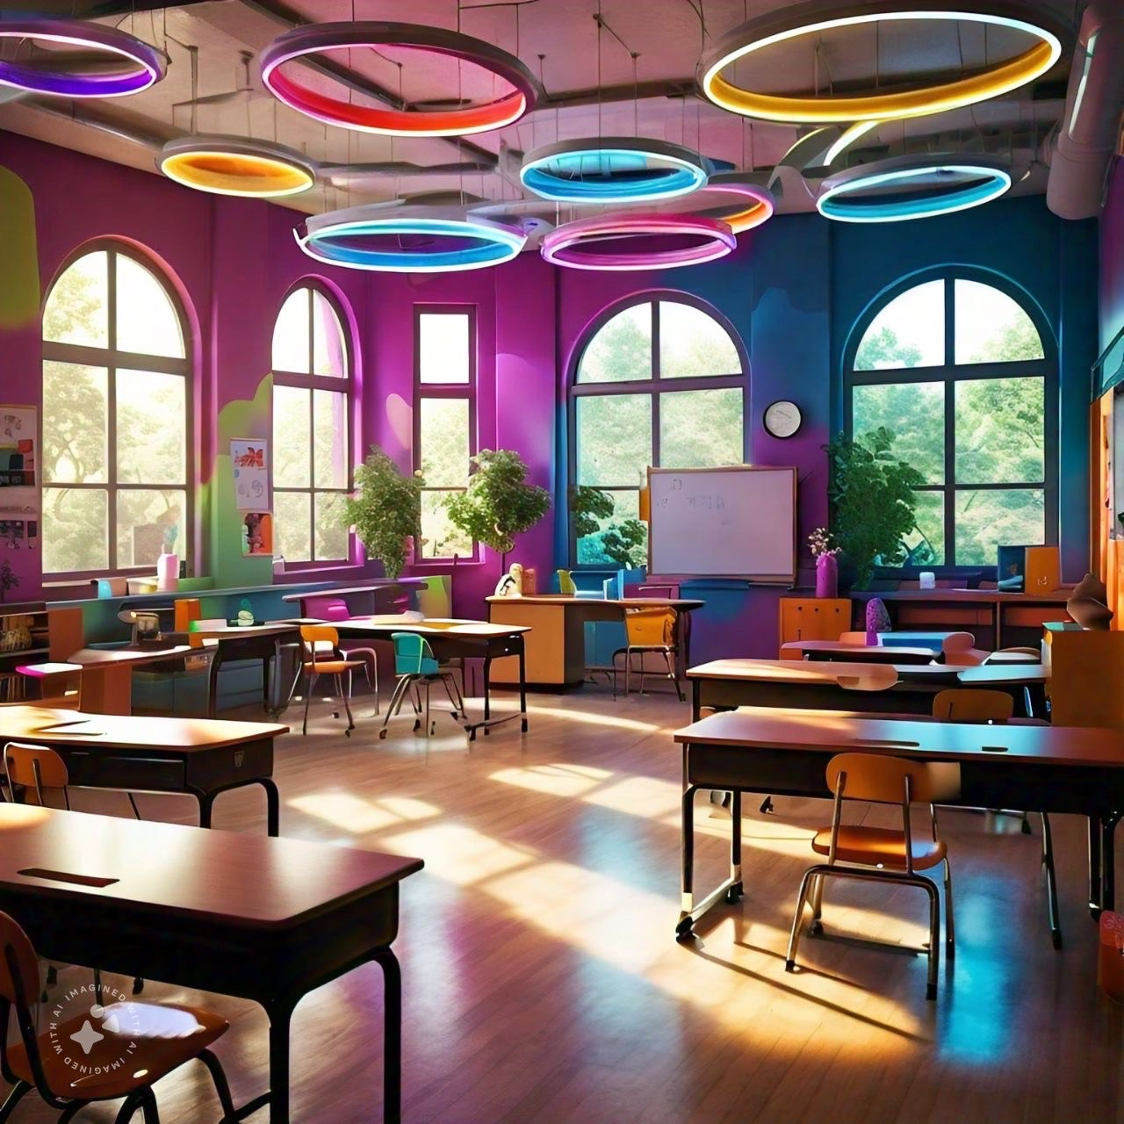
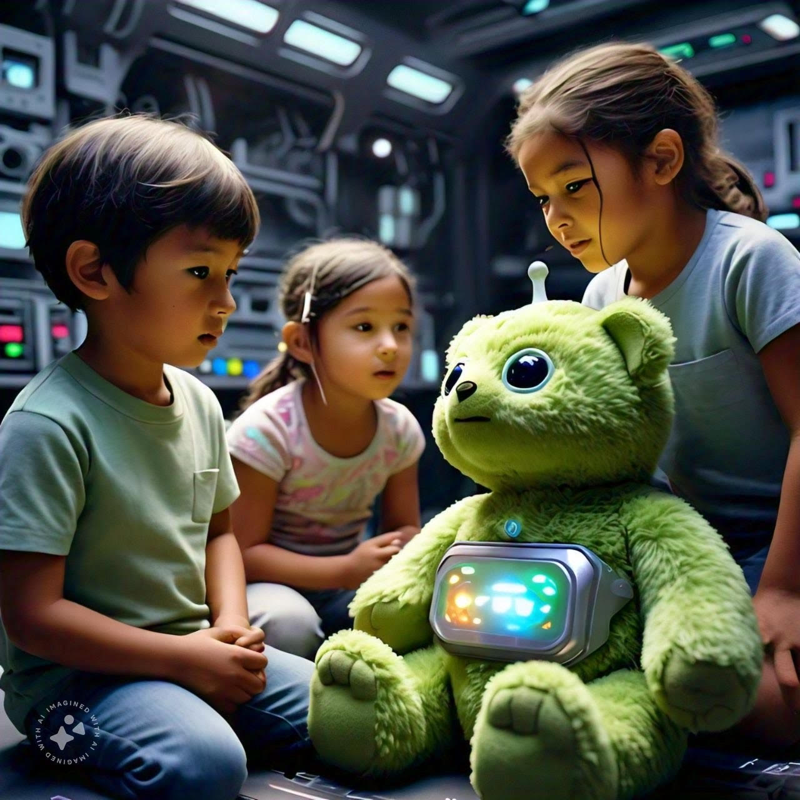
how does it work?
The LUM-1N is a real-time interaction toy between the astronauts and students of all ages. This artifact has a cute and friendly alien shape, with sensory features that respond to the astronauts activity near him. Touching, rubbing, hugging, talking, or even just passing by will generate a reaction on the creature’s twin on earth through light, sounds, vibrations and live broadcasts, a modern and walkie talkie that will keep the space team grounded and connected with future little astronauts. Learning about science, technology, and space exploration will feel more exciting than ever, promoting curiosity and inspiration in the next generation of geniuses.

Slide 5

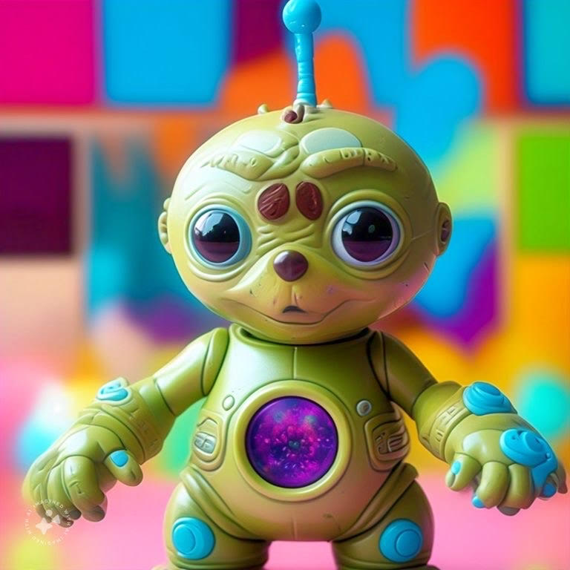
Features
Imagine receiving a greeting from outer space while you study. A hug from the astronaut while portraying that warm touch in a series of color-coded light waves in the LUM-1N’s antennas.
A small screen in the creature’s belly will allow astronauts to have videocalls with students sharing quality time, creating educational missions, and receiving questions from kids to learn about science and outer space.
The use of AI will allow the creature to translate voice messages to different languages.

Slide 6
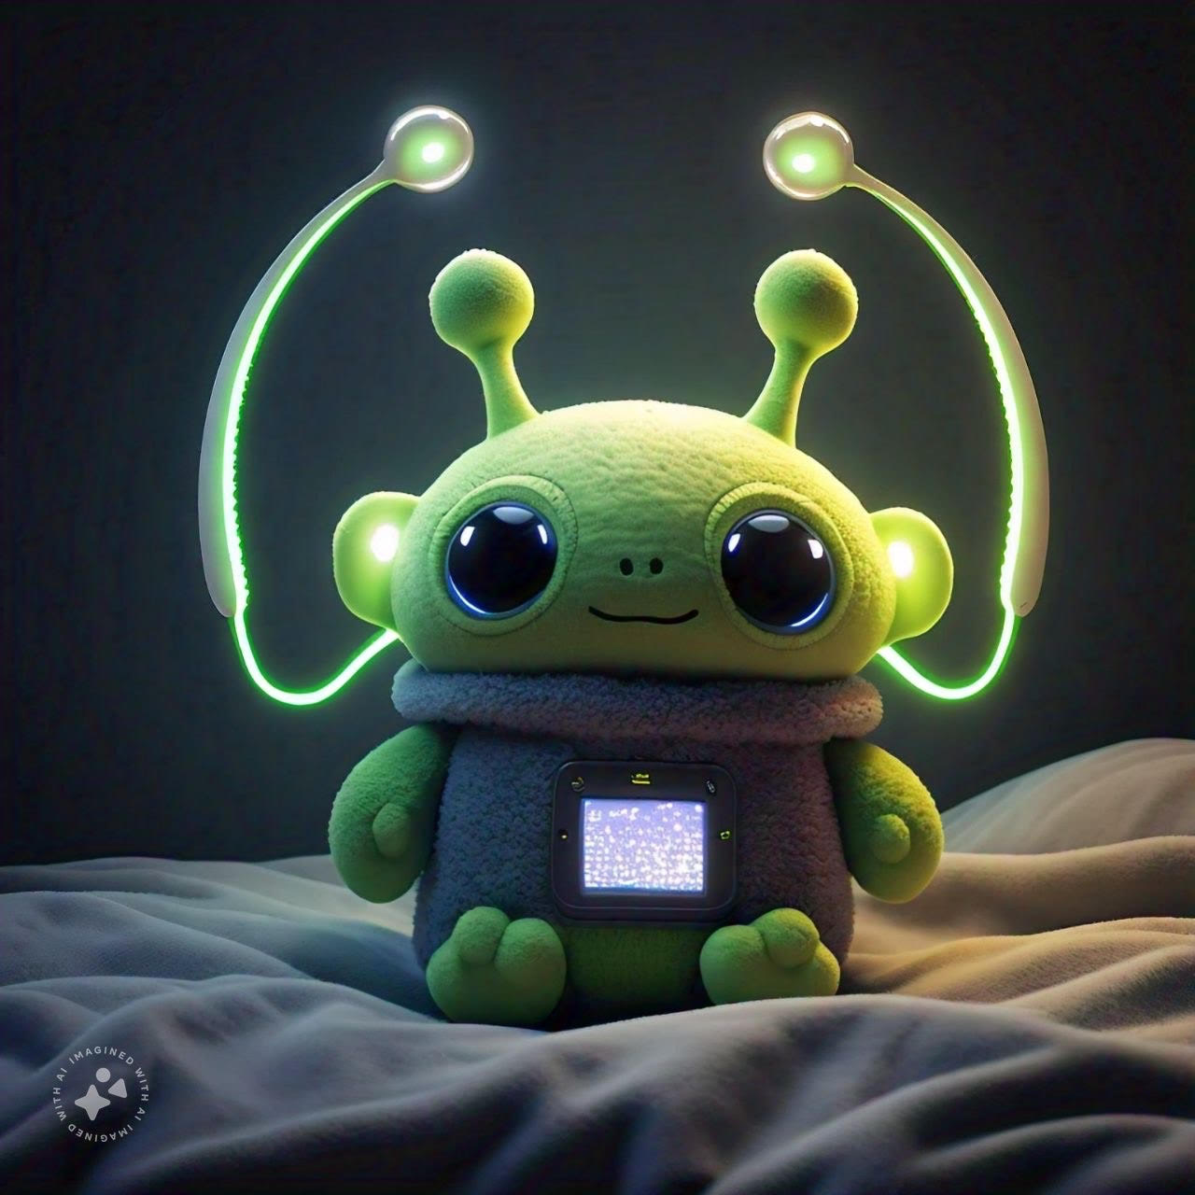
Activities, games, and missions
Space mission simulations: Children could follow simple steps to simulate space missions like landing a launched rocket.
Scientific experiments: The astronauts could guide kids in experiments who showcase principles like gravity, atmospheric pressure, or how to grow plants in space without direct sunlight. This could allow kids to replicate exciting scientific discoveries with basic materials.
Collaborative challenges: Kids could learn to work in teams just like space professionals, with the astronauts proposing group challenges, like creating a moon space base or copying a mars mission.

Slide 7
Benefits
Challenges
1.⁠ ⁠Quality access to education: Childhood and youth with limited educational opportunities could have access to a better quality education in science and technology.
2.⁠ ⁠Inspiration and motivation: The project can inspire youth to follow careers in science, technology, engineering, and math (STEM).
3.⁠ ⁠Cultural connection:The project fosters cultural connection between NASA astronauts and communities from all over the world.
1.⁠ ⁠Infrastructure: The lack of infrastructure in certain communities can be an obstacle for the project develpment and safety.
2.⁠ ⁠ ⁠Mainteance: The mainteance of the plush and the features can require additional resources and support.
3.⁠ ⁠Production: The creation of the creature will require professionals from different fields: programming, technology, language, engineering, etc.

Slide 8
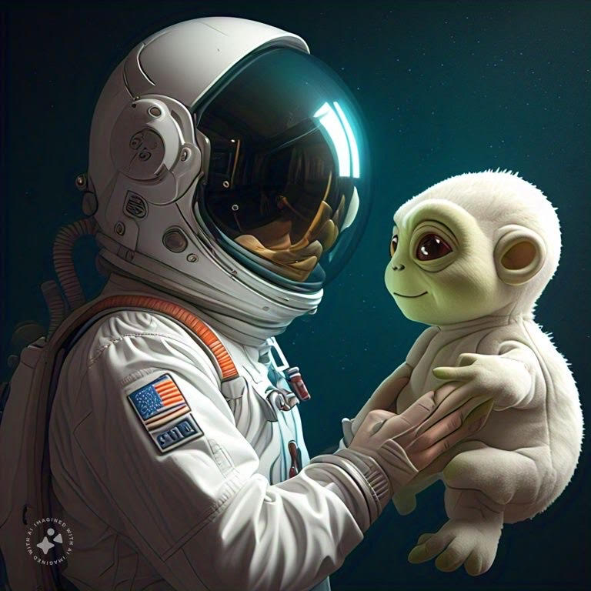
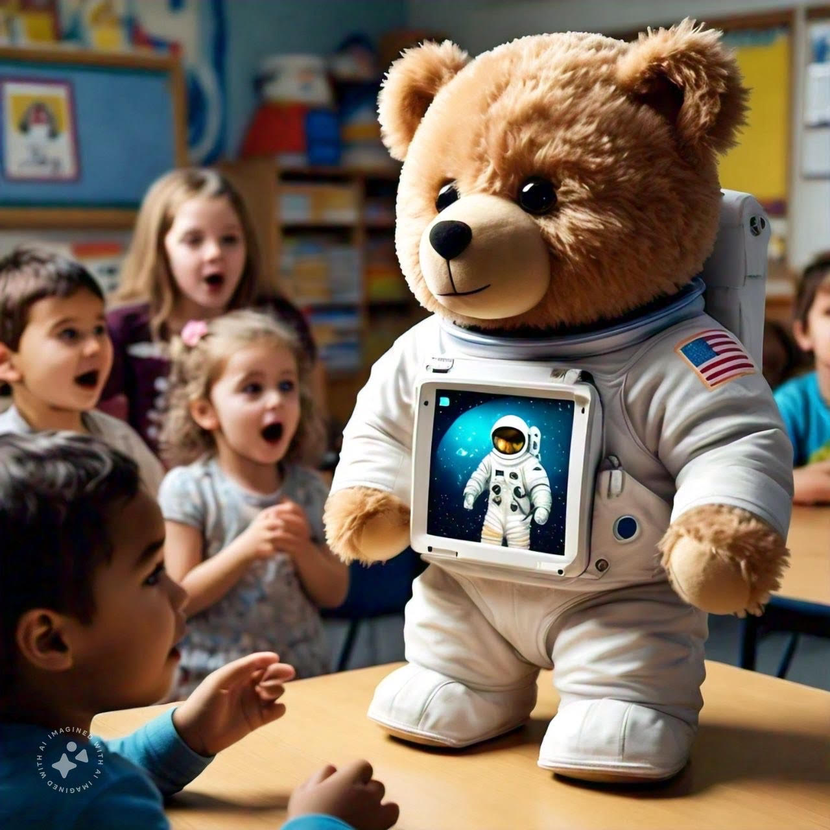
Social impact
The final purpose of the project is to improve education through neural network models trained to recognize specific features and the use of OpenCV libraries that scan the kids behaviors and intelectual needs. The system must evaluate speed, accuracy, and creativity of the kids responses to the stimuli of the astronauts.

